Slide 1
Unit 1 – Introduction to SuccessFactors Integration
Leslie Jane Fajutagana

Slide 2







Objectives
Compare SFAPI
and
ODATA
Define
Metadata
Identify Data Model of SuccessFactors
Identify Integration Monitoring
Tools
Define SuccessFactors Employee Central
Enumerate Challenges
in SF Integration

Slide 3

Systems, Applications and Products
(German: Systeme, Anwendungen, Produkte)
SAP is a German multinational software company known for making enterprise resource planning (ERP) software. ERP software allows organizations to manage business operations, and usually refers to suite of modular applications that collect and integrate data from different aspects of the business.

Slide 4

Cloud Computing at SAP
SAP is a cloud company driven by SAP HANA in-memory technology.
Simply put, cloud computing makes it possible for users to access data, applications, and services over the Internet. The cloud eliminates the need for costly hardware, such as hard drives and servers – and gives users the ability to work from anywhere.
Cloud computing is divided into three broad service categories: Software-as-a-Service (SaaS), Platform-as-a-Service (PaaS), and Infrastructure-as-a-Service (IaaS).

Slide 5

SaaS Products
SAP SuccessFactors HR Solutions
SAP S/4HANA Finance
SAP S/4HANA Cloud (Cloud ERP for large enterprise and midsize business)
SAP Hybris Cloud for Customer
SAP Hybris Sales Cloud
SAP Hybris Service Cloud
SAP Hybris Marketing
SAP Hybris Commerce
SAP Business ByDesign (Cloud ERP for Midsize Business)
SAP Analytics Cloud
SAP Jam Collaboration
SAP Jam Communities
SAP Integrated Business Planning
Ariba Network: Sourcing, Procurement, & Finance
Concur: Travel & Expense Management
Fieldglass: Flexible labour Management

Slide 6

SAP SuccessFactors is a global provider of cloud-based human resource software and fully integrated human capital management (HCM) systems.

Slide 7
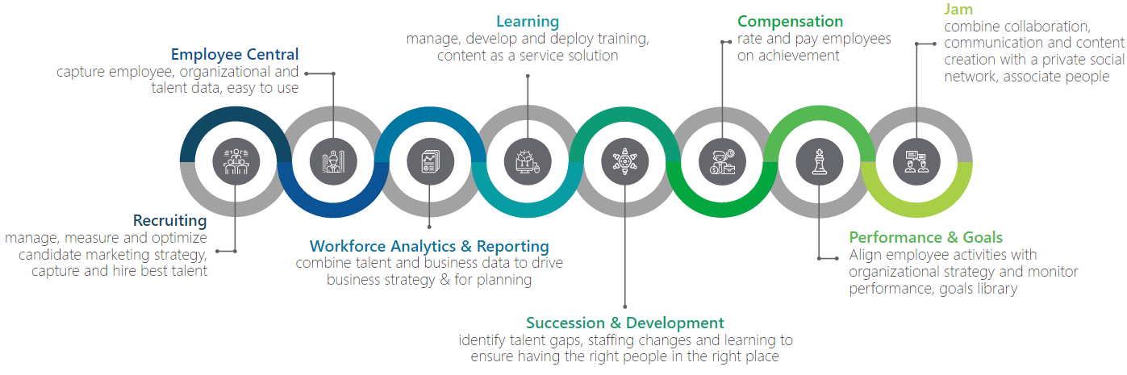
SuccessFactors Modules

Slide 8
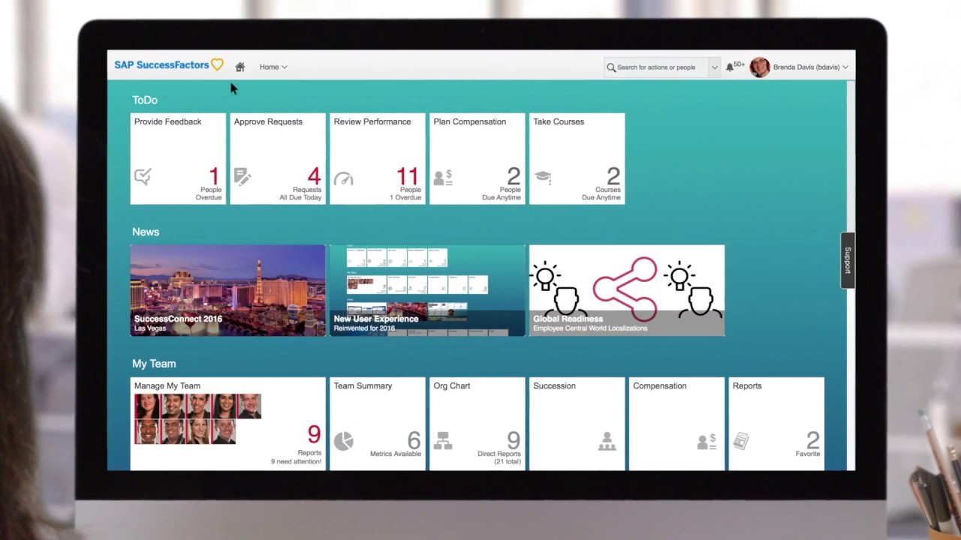

Slide 9
Employee Central
Employee Central is an HCM System that enable to collect and manage Personal Information and Employment Information.
SAP SuccessFactors Employee Central is the foundation upon which all other SuccessFactors modules sit, interface, and build upon, making it the ultimate “system of record.”

Slide 10
Employee Central
Employee Objects
Comprises personal and employment details for employees, referred to as Person Objects and Employment Objects
Foundation Objects
Comprises organization, pay and job structure details.
Metadata Framework (MDF) Objects
Web-based software that gives SuccessFactors users the ability to create and maintain custom objects, screens and business rules to extend the platform’s functionality.

Slide 11
Business Rules
Business Rules provide a rich and easy to use graphical interface to implement simple business logic.
The Rules Engine allows you create rules using If and Then logic. These rules can be attached to objects and can provide business logic or validation of data input.
Initializing the default value for field(s) within an object
Changing the value of field(s) based on the selection of a value in another field
Validating the set of values in the fields before saving an object instance and firing off a validation message in case of an error
Creating Dynamic UI Behavior: for example, hiding or showing a field or a group of fields

Slide 12
Rule Trigger Operations
Initialize
Change
Validate
Calculate

Slide 13
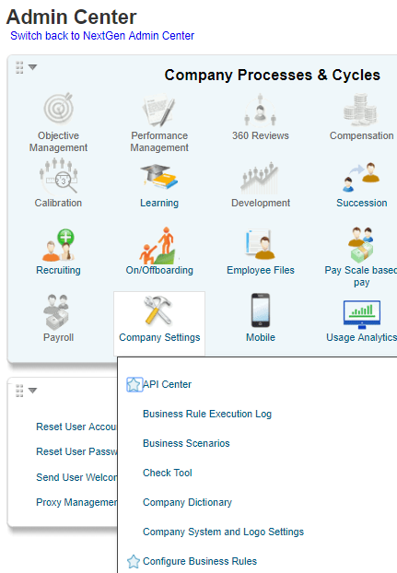
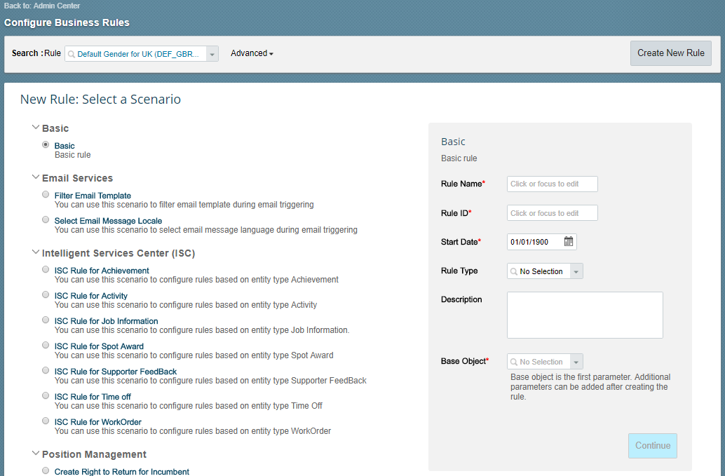

Slide 14
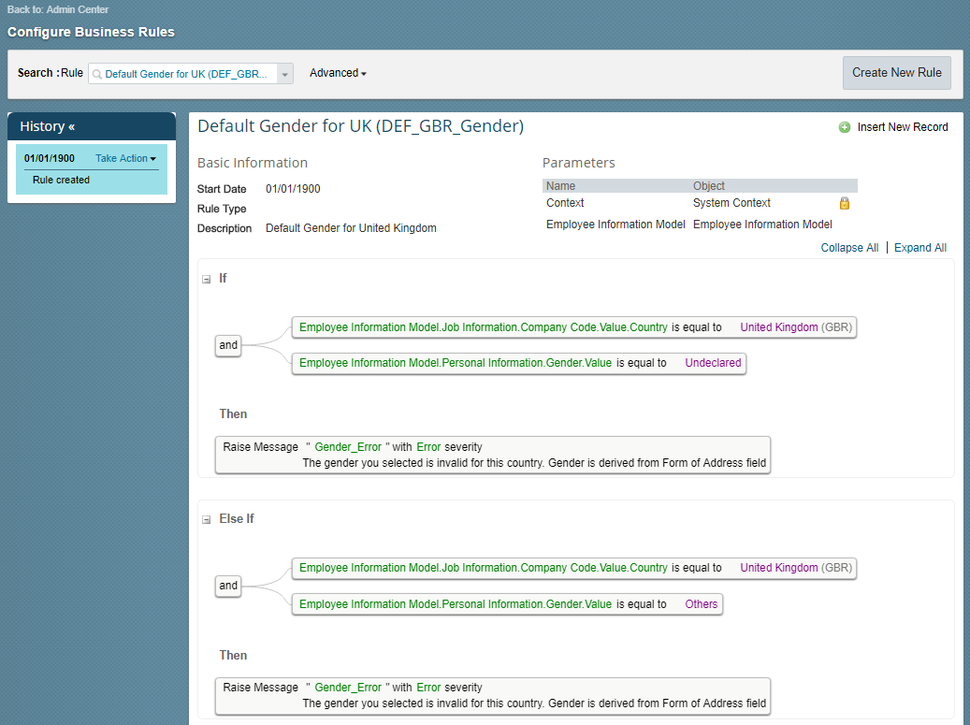

Slide 15
Foundation, Personal and Employment Objects
The Employee Central OData API supports metadata query, entity query and upsert query for these objects.
Metadata Query
All users belonging to a company will get the same metadata query results. Results are not determined by the RBP permissions for EC entities.
https://<hostname>/odata/v2/$metadata
Entity Query (Operation GET)
Most FO objects and person/employment related entities support OData query. For details, check the OData API dictionary or the results of the metadata operation.
Entity Upsert (Operation UPSERT)
Most Employee Central entities support the upsert operation which is based on the Employee Central import. This means the restrictions that apply to the Employee Central Import also apply to the entity upsert. For example, field level permissions are not supported. Additional information can be found in Administrator Guide, Employee Central Imports.

Slide 16
Entity
– Fields in table structures
– Allows the creation, manipulation of employee data, and navigation of entity associated between entities
Employee Objects
Person Objects – entities starting with Per*
Employment Objects – entities starting with Emp*
Foundation Objects
– Entities beginning with FO*

Slide 17




Properties of Entity
Effective Dating
Allows you to make scheduled changes to a record.
Business Keys
Uniquely identifies an entity
Processing parameters for upsert
Both full purge and incremental purge are supported.
Required/nullable attribute
Attribute set by the data model. For business keys, Required is always set to TRUE.

Slide 18
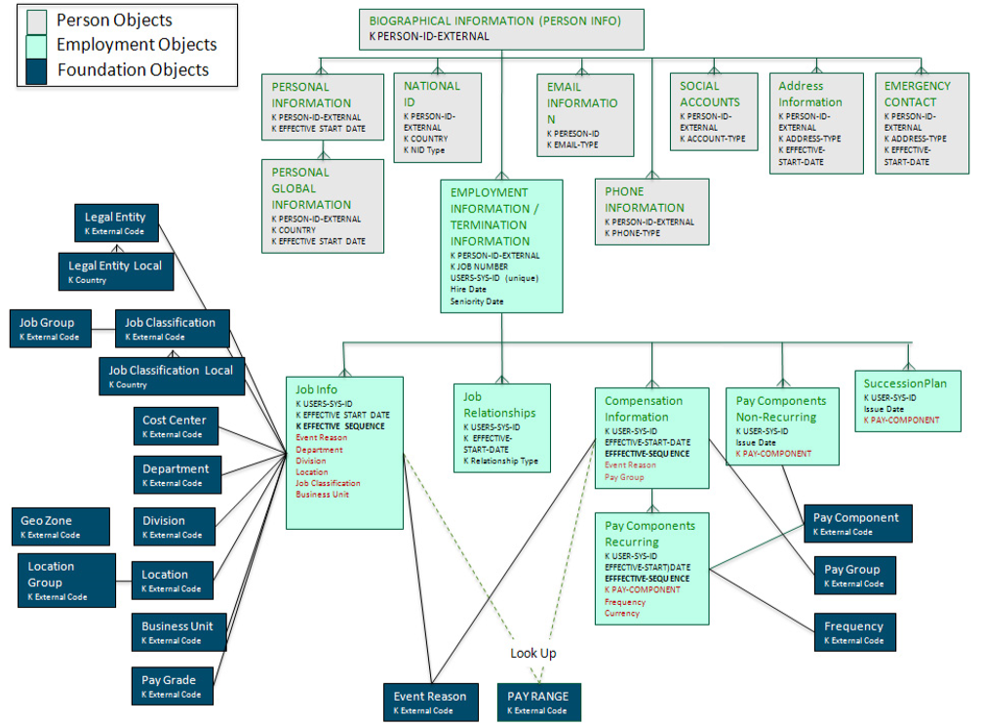
Employee Central Entity Relationship Diagram

Slide 19
Employee Central Person Entities
<Biographical Information>
PerPerson
personIdExternal
<Personal Information>
PerPersonal
<National ID>
PerNationalId
<Email Information>
PerEmail
<Phone Information>
PerPhone
<Address Information>
PerAddressDEFLT
personIdExternal
startDate
personIdExternal
cardType
country
personIdExternal
emailType
personIdExternal
phoneType
personIdExternal
startDate
addressType
<Personal Global Information>
PerGlobalInfo
<Emergency Contact>
PerEmergencyContacts
personIdExternal
startDate
country
personIdExternal
name
relationship

Slide 20
Employee Central Employment Entities
<Employment Information>
EmpEmployment
personIdExternal
userId
<Compensation Information>
EmpCompensation
<Job Relationships>
EmpJobRelationships
<Job Information>
EmpJob
<Work Permit>
EmpWorkPermit
<Pay Components Non-Recurring>
PerAddressDEFLT
userId
startDate
seqNumber
userId
startDate
relationshipType
userId
startDate
seqNumber
userId
documentType
documentNumber
Country
userId
payDate
payComponentCode
<Pay Components Recurring>
EmpPayCompRecurring
userId
startDate
seqNumber
payComponent

Slide 21
Employee Central Foundation Entities
<Job Information>
EmpJob
userId
startDate
seqNumber
<Legal Entity>
FOCompany
<Cost Center>
FOCostCenter
<Division>
FODivision
<Business Unit>
FOBusinessUnit
<Department>
FODepartment
externalCode
startDate
externalCode
startDate
externalCode
startDate
externalCode
startDate
externalCode
startDate
<Job Classification>
FOJobCode
<Location>
FOLocation
<Pay Grade>
FOPayGrade
<Event Reason>
FOEventReason
externalCode
startDate
externalCode
startDate
externalCode
startDate
externalCode
startDate
<Job Classification Local>
FOJobClass<country>
country
externalCode
startDate

Slide 22
SuccessFactors Integration API
Open Data Protocol (OData)
SuccessFactors Data API (SFAPI)

Slide 23
Open Data Protocol (OData)
It is a standardized protocol for creating and consuming data APIs.
This OData API is used to configure entities.
Each SuccessFactors module can be accessed using its own set of entities.

Slide 24
What is an Employee Central OData API?
The Employee Central OData API exposes the Employee Central entities and this includes foundation objects, Personal, Employment, and MDF objects.

Slide 25
When is an Employee Central OData API used?
Use of Role Based Permission (RBP) concept
Concurrent user access with an extension platform to build your own UIs on top of Employee Central
MDF data access
Replicate data in Admin Mode for read and write operations. Admin Mode is used chiefly for technical integrations.

Slide 26
OData API Dictionary
The OData API dictionary contains all the entities available in your instance. It lists the allowed operations, the field (property name), and the label indicating which fields are required or not.

Slide 27
Examples of OData Entities
Foundation Objects
Examples: FODepartment, FODivision, FOBusinessUnit
Employment Objects
Examples: EmpJob, EmpEmployment, EmpCompensation
Person Objects
Examples: PerPerson, PerPersonal, PerEmail
Workflow Objects
Examples: WfRequest, WfRequestStep
Platform Objects
Examples: User, Picklist
MDF Objects
Example: Position

Slide 28
How to check OData in SAP SuccessFactors UI
Log in to your SAP SuccessFactors system
Go to Admin Center
Click on Company Settings
Click on "OData API Data Dictionary"

Slide 29
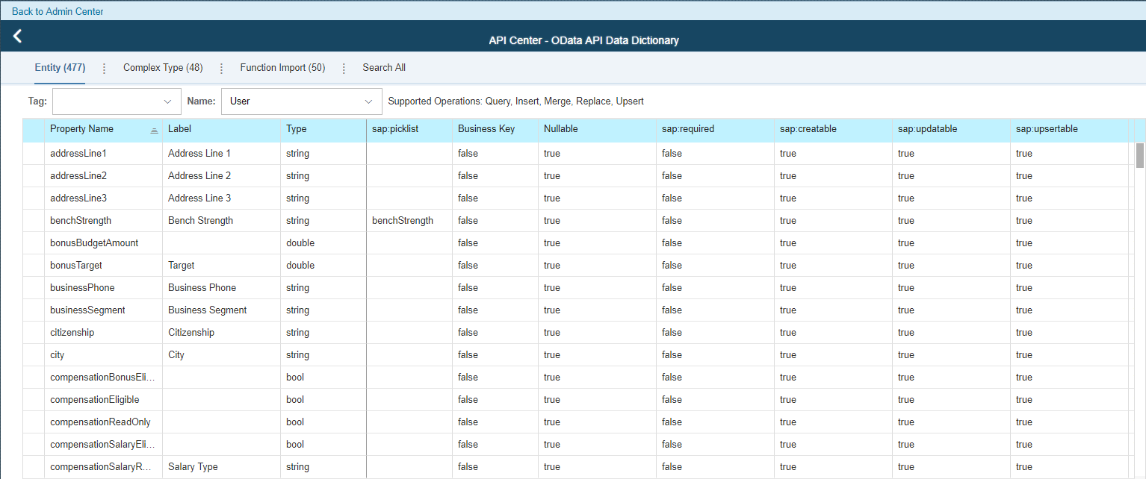

Slide 30
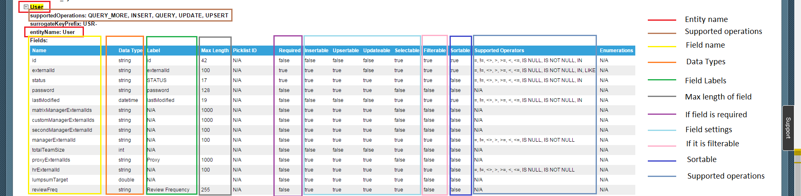

Slide 31
SuccessFactors Data API (SFAPI)
It is a SOAP Web Service designed for importing and exporting data to and from your SuccessFactors instance.
It provides generic CRUD (Create, Read, Update, Delete) operations to access data, as well as metadata operations to allow runtime discovery of the data.

Slide 32
How to check SFAPI in SAP SuccessFactors UI
Log in to your SAP SuccessFactors system
Go to Admin Center
Click on Company Settings
Click on "SFAPI Data Dictionary"

Slide 33
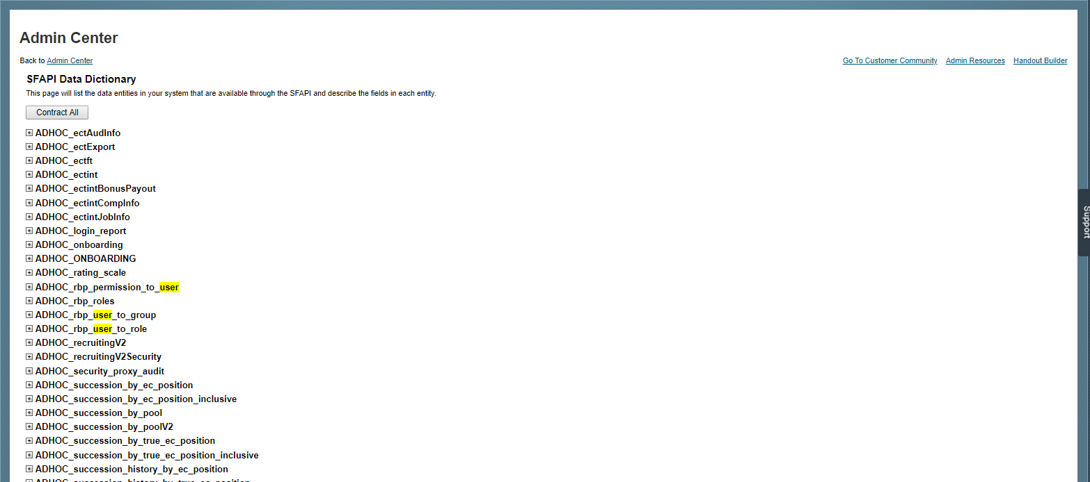

Slide 34


Slide 35
What is Metadata
In order to get extra information, such as language labels, picklists, beyond what the standard OData metadata provides, SuccessFactors OData exposes metadata as an entity.
The SuccessFactors OData API exposes an entity named 'Entity'. Its properties are exposed as complex type value embedded in the response body of 'Entity'. Different forms of metadata can thus be exposed without changing the standard OData metadata format. The new metadata can be accessed like a regular entity. In addition, it supports a simple filter to output metadata of a specific entity or a group of entities.

Slide 36
Sample API Calls
Access the entire metadata for your instance
https://api4.SuccessFactors.com/odata/v2/$metadata
Access the metadata for User entity
https://<hostname>/odata/v2/Entity('User')?$format=json
Access the metadata for the User and Photo entities
https://api4.SuccessFactors.com/odata/v2/User,Photo/$metadata
Query User entity data
https://api4.SuccessFactors.com/odata/v2/User,Photo/User?$format=json&$filter=userId eq ‘cgrant’

Slide 37
Integration Monitoring Tools
OData Audit Log
In the OData API Audit Log, audit log can be displayed information such as the time a request was made, the time taken for the response, the type of OData API call, and so on.
SFAPI Audit Log
In the SF API Audit Log, audit log information can be displayed such as the time a request was made, the time taken for the response, the type of SF API call, and so on.

Slide 38
Integration Monitoring Tools
Event Notification
Audit Log
All the information regarding the event such as ID, event type, subscriber, status, event details, sent by, Send time and Correlation ID.

Slide 39
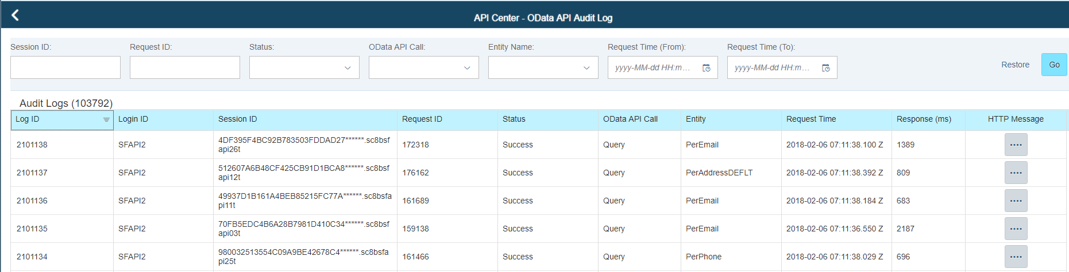
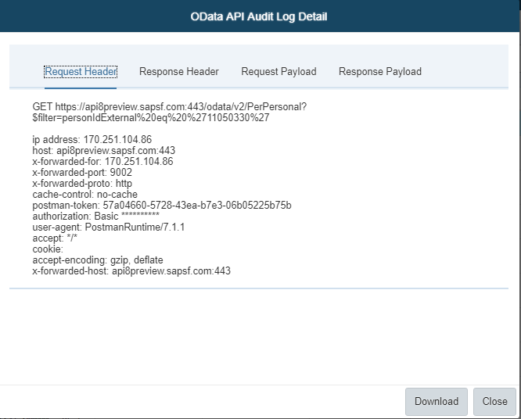
OData Audit Log

Slide 40
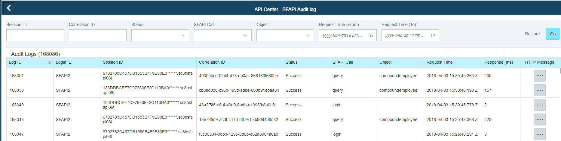
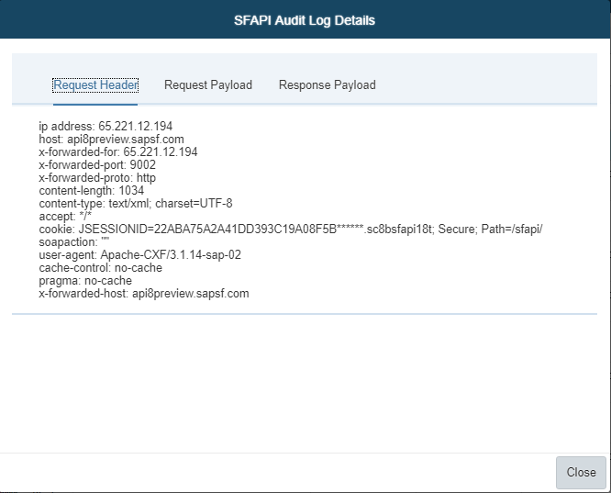
SFAPI Audit Log

Slide 41
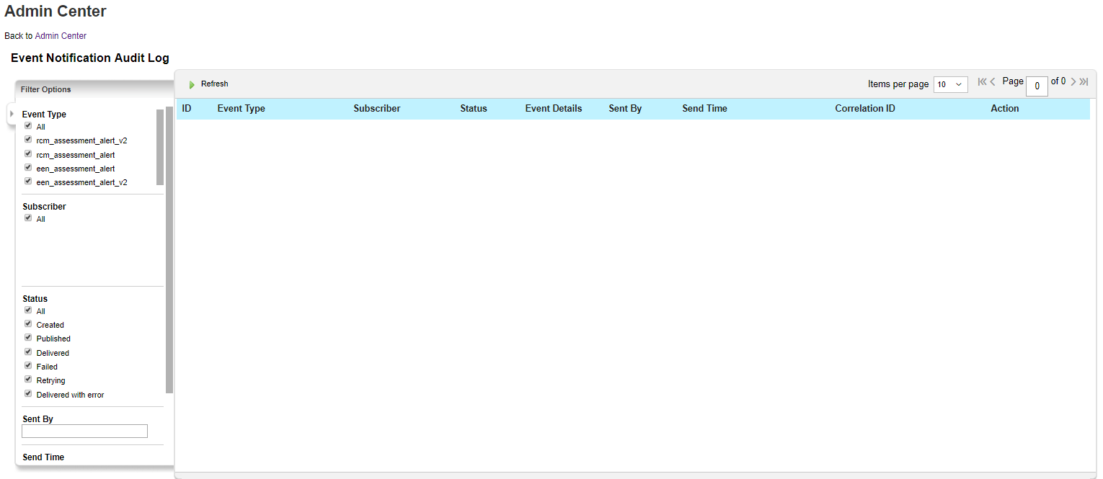
Event Notification Audit Log

Slide 42
Software Minimum Requirements for Employee Central Integration
Product | Product Version | Component | Comments
SAP SuccessFactors BIZX Core | SuccessFactors BIZX core | SFSF Employee Central | SuccessFactors Cloud
SAP ERP Central Component | SAP ERP 6.0 Netweaver Release 7.00 SP27; 7,01 SP12; 7,02 SP8; 7,10 SP15; 7,11 SP10; 7,30 SP3; 7,31 SP7; 7,40 SP7 |  | On Premise
Application Component | SAP_APPL_600 SP15 or higher ODTFINCC 600 SP10 or higher PA_SE_IN 100 (message based employee data replication) |  | On Premise *ODTFINCC is for cost centre integration * PA_SE_IN 100 is for all other integrations
SAP Cloud Platform Integration |  |  | formerly SAP HANA Cloud Integration

Slide 43
Security Access Requirements
System | Access Required
SAP | Security Team will be responsible for giving authorizations
SAP Cloud Platform Integration services | Access to SAP Cloud Platform tenant
SAP SuccessFactors | Administration access including creating user and setting up user permissions Provisioning access

Slide 44
There are 3 sections to prepare the SAP SuccessFactors for replication:
Section 1 - Enable SFAPI Web Services
Section 2 - Creating SuccessFactors API User
Step 1 - Import API User
Step 2 - Maintain Permission Groups
Step 3 - Maintain Permission Roles
Section 3 - Set API Login Exceptions

Slide 45
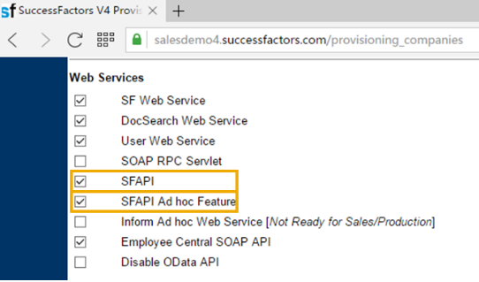
Section 1 Enable SFAPI Web Services
This step describes how to enable SFAPI Web Services in Provisioning Tool. Once enabled, SAP ERP and SuccessFactors Employee Central can communicate through a technical API user.
Log on to the provisioning.
Click the company list.
Click Company Settings and then locate Web Services.
In the Web Services section, enable SFAPI and SFAPI Adhoc Feature by choosing the checkboxes.
Choose Save and confirm the changes.

Slide 46
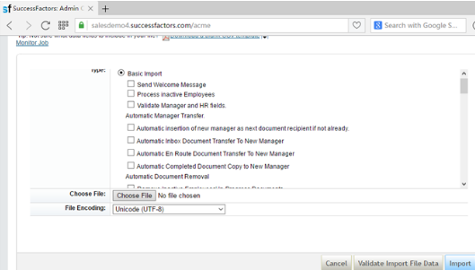
Section 2 Import API User

Slide 47
Section 2 Step 1 – Import API User
This step is required to set up an API user in order for the integration scenarios between SAP ERP HCM or SAP S/4HANA and SuccessFactors to be executed using SAP Cloud Platform Integration (CPI) connections.
Log on to SuccessFactors as Administrator.
Go to Admin Center > Manage Employees > Update User Information > Employee Export > Export User File.
In the exported file, select and remove all rows except the first 2 header rows.
Add rows for the user IDs you require. For example, sap_api_user.
Go back to Admin > Manage Employees > Update User Information > Import Employee Data > Basic Import> Choose File.
Select and upload the user ID csv file.
Choose Validate Import File Data to check it.
Once the validation succeeds, import the user ID csv file.

Slide 48
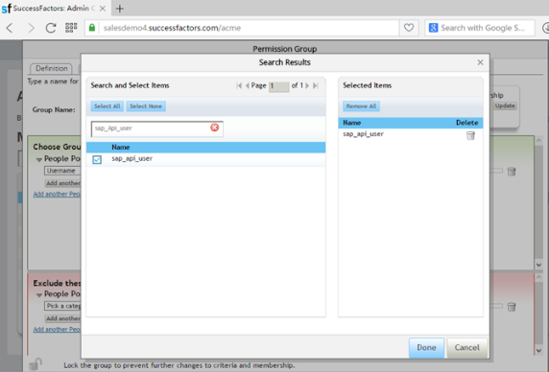
Section 2 Step 2 - Maintain Permission Groups
This step describes the setup of a permission group for accommodating a permission role to be created in Step 3.
Log on to SuccessFactors as Administrator.
Go to Admin Center > Manage Employees > Set User Permissions > Manage Permission Groups > Create New
On the Permission Group page, maintain the following entry: Group Name: SFAPI
In the Choose Group Members section, select Username as the category for Permission Group SFAPI.
Search the SFAPI system user. For example: sap_api_user.
Choose Done to complete the process.

Slide 49
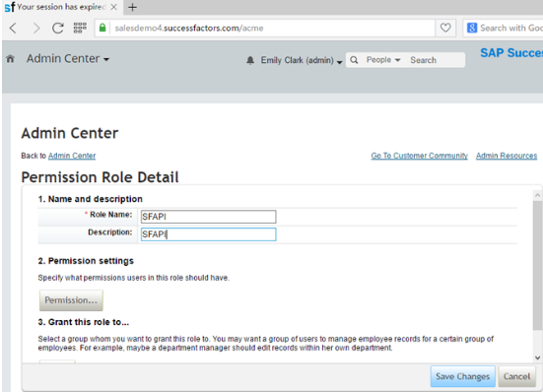
Section 2 Step 3 – Maintain Permission Roles

Slide 50
Section 2 Step 3 – Maintain Permission Roles
This step describes the set up steps necessary to grant security access to the SAP API user ID created in the step above when RBP has been activated.
Log on to SuccessFactors as Administrator.
Go to Admin Center > Manage Employees > Set User Permissions > Manage Permission Roles > Create New
On the Permission Role page, maintain the following entry: Role Name: SFAPI
In the Permission Settings section, choose the Permission button to specify the permission you want to assign to the role.
Under 3. Grant this role, choose the Add button to specify the permission group you want to assign to the role.
For the Target population, select the checkbox for everyone.
Choose the Done and save changes to complete the creation of the role.

Slide 51
List of Permission Roles
Role | User Permissions | Administrator Permissions | Permission Groups | Target Population
SFAPI | General User Permission – SFAPI User Login | Manage Integration Tools – Access to SFAPI Audit Log Access to SFAPI Metering Details Access to SFAPI Data Dictionary Admin access to OData API Manage User – Employee Export Employee Central API – Employee Central Foundation SOAP API Employee Central HRIS SOAP API Employee Central Foundation OData API (editable) Employee Central HRIS OData API (editable) Metadata Framework – Read/Write Permission on Metadata Framework Import Permission on Metadata Framework | SFAPI | Everyone

Slide 52
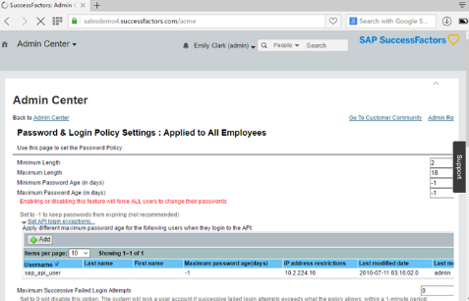
Section 3 Set API Login Exceptions
This section describes how to ensure that the password for the API user does not expire.
Log on to SuccessFactors as Administrator
Go to Admin Center > Company Settings > Password & Login Policy Settings > Set API Login Exceptions
Choose Add.
Make the following settings:
Username: The API user. For example, sap_api_user.
Maximum password age (days): Set to -1 days
IP address restrictions: Designated IP address(es) or address range from which the API user is being accessed from. For example, 10.2.224.10.
Choose Save & Close.

Slide 53
Challenges
Some operations of several entities are not applicable to OData.
Configuration issues of adapter, flow step, integration process, local integration process or integration flow configuration
Resource specific issues like errors in mapping file etc.

